Slide 1
Week 10/2

Slide 2
Timeline
Mon
Tues
Wends
Fri-Sun
Team meeting with Dr. Ravikumar
Self-Work
Team meetings with TA and team work time
Self-Work
Past Week

Slide 3
Recap & Feedback
Met with Dr. Gelli Ravikumar and every member presented for 5 minutes regarding their understanding of Helics.
Met with our TA to discuss next week’s assignments:
Project plan assignment and lightning talk

Slide 4
Overview of Work
Explore CyHELICS, pandapower, and OpenDSS

Slide 5
Actual Work
Met as a group to review last week’s advisor meeting
Talked over the preamble and team contract
Started exploring Helics and Pandapower
Got Pandapower to run a basic example that they had on their website
Talked over possible power grid designs and OpenDSS
Talked over the broad scope of the project and what we want to focus on this semester
We want to try and get the power grid stuff as much done as possible this semester to make next semester easier to jump into.
Messed with Security Onion (partially did this for the CDC. This was all I had time for this last week so I won’t submit audio for the update - Tyler)

Slide 6
Zach - Work
HELICS Installation & Examples:
Successfully installed HELICS on my test VM
Ran through a few HELICS examples

Slide 7
Zach - Future Work
Connect HELICS / Panda Power
Continue working with Pand Power

Slide 8
Kaya - Work
Ran Helics on a VM
Encountered issues with running it, had to edit the json file (changed exec field in fundamental_default_runner_ since my python command is different), then it worked fine.
Downloaded and experimenting with pandapower
Tests to see if it installed correctly runs fine
Beginner’s program example has a circular imports error
Started reading the user manual for OpenDSS
Power system harmonics analysis tool, even though it's most often used as a power flow program.
Designed to perform nearly all aspects of distribution planning for distributed generation.

Slide 9
Tommy- Work
PandaPower:
Performance of panda power is much faster than MATPOWER and PYPOWER especially for larger bus grid models
Pandapower is tested with pytest. The tests also include automatic validation of pandapower results from power flow or short circuit calculations against commercial software, to ensure that the implementation is correct.
Validates model using DIgSILENT PowerFactory or PSS Sincal to ensure load flow deviations do not surpass tolerances
Will good be good to double check our grid model
OpenDSS:
Began to read more in depth on OpenDSS
Found a Cheat Sheet made by the creators with commonly used commands and descriptions of the command

Slide 10
Work - Matthew
OpenDSS:
OpenDSS focuses on the distribution grid model.
Provides a wide range of capabilities
Unbalanced, multi-phase power flow
Quasi-static time-series (QSTS)
Fault analysis
Harmonic analysis
Flicker analysis
Dynamic (electro-mechanical) analysis
Linear and non-linear analysis
Stray voltage/current analysis
First platform to include detailed energy storage and advanced inverter data and is instrumental in developing new distribution system analytics, such as the hosting capacity methods applied in EPRI’s distribution resource integration and value estimation (DRIVE) tool.
This will allow us to model battery banks/renewable energy generation.

Slide 11
Work - Matthew
SourceForge
https://sourceforge.net/p/electricdss/news/
Source Forge provides a wiki and discussion forum where users can post questions and look for assistance from other users.
Also provides a detailed description of how to download open DSS properly and set up the program.
This website looks like it will be useful if we run into technical issues
Cheat sheet/User Manual
After reading through each, I found information about different files (.exe, .DLL), power flow solution types (Iterative power flow and direct solution), and interactive algorithms ("Normal" current injection mode (default) and "Newton" mode).

Slide 12
Work - Matthew
Plotting with OpenDSS
Page 41 of the user manual explains how to plot different analysis information from OpenDSS.
Plots can be based on line thickness to indicate the value (thick = high value, thin = low value).
Several plots can be made such as harmonic resonance and voltage profile.
Circuit Models
Bus and terminal models can be made (no special bus types, slack or load).
Each electrical element in the power system has one or more terminals. Each terminal has one or more conductors. The conductors are numbered [1, 2, 3,…]. Each conductor conceptually contains a disconnect switch that can be controlled by a control element.

Slide 13
Work - Justin
I worked on OpenDSS and some of the abilities that it has.
I learned that:
It must be installed on Windows (Ubuntu is not really an option)
It can have Excel documents generated.
This data can be turned into a graph (NEED TO FIGURE OUT HOW)
Scripts are simple to make and edit

Slide 14
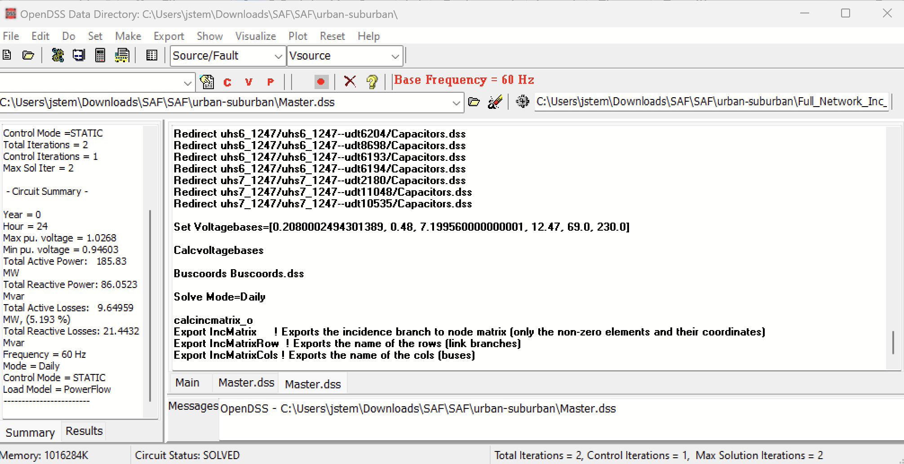
Work - Justin

Slide 15
Work - Justin
Next steps
Learn how to integrate with other software (PandaPower and HELICS)
Learn some more of the commands and how to integrate them into the scripts.

Slide 16
Next Week's Plan
Get access to, and set up the VMs
Installing Helics, pandapower, openDSS, git, visual studio so this box can be copied out for all members
Create project plan

